Slide 1
Java EE
Java Server Page (JSP)
Java Server Pages (JSP)
JSP Scripting Elements
Implicit objects
JSP Tags
JSTL
Building Web Applications using MVC 2 Architecture

Slide 2
JSP Introduction
JavaServer Pages Technology
JavaServer Pages (JSP) technology allows you to easily create web content that has both static and dynamic components. JSP technology makes available all the dynamic capabilities of Java Servlet technology but provides a more natural approach to creating static content.
The main features of JSP technology are as follows:
A language for developing JSP pages, which are text-based documents that describe how to process a request and construct a response
An expression language for accessing server-side objects
Mechanisms for defining extensions to the JSP language
What Is a JSP Page?
A JSP page is a text document that contains two types of text: static data, which can be expressed in any text-based format (such as HTML, SVG, WML, and XML), and JSP elements, which construct dynamic content.

Slide 3
JSP Processing
Internally, JSP gets converted into a Servlet
When the user requests for a .jsp file for the first time, the JSP Container will create a Servlet that would produce the output that the .jsp file is supposed to produce.
Starting from the second request, there is no overhead of compilation
Programmer
writes
Is loaded and
initialized as
Is translated to
Compiles to
Java Source Code
Byte code
JSP
Servlet
MyJsp.jsp
MyJsp_jsp.java MyJsp_jsp.class
MyJsp_jsp Servlet
In the end, a JSP is just a Servlet
3

Slide 4
Servlet Vs JSP
Servlet | JSP
Handles Dynamic data | Handles Dynamic data
Handles business logic | Handles presentation logic
Lifecycle methods init() : can be overridden service() : can be overridden destroy() : can be overridden | Lifecycle methods jspInit() : can be overridden _JspService(): cannot be overridden jspDestroy() : can be overridden
Html within java out.println(“<html><body>”); out.println(“Time is “+ new Date()); out.println(“</body></html>”); | Java within html <html><body> Time is <% new Date() %> </body></html>
Runs within a Web Container | Runs within a Web Container
4

Slide 5
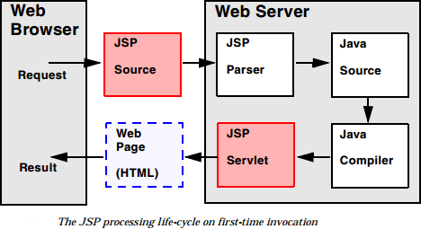
JSP Life Cycle
Following are the steps followed by a JSP Container:
Phases
Translation Phase : Parsing the JSP i.e. xxx.jsp -> xxx.java
Compilation Phase : xxx.java->xxx.class
Execution Phase : xxx.class -> instantiation-> servlet
Initialization (invokes the jspInit() method)
For Each request , the _jspService() method is invoked
Cleanup (The destruction phase of the JSP life cycle represents when a JSP is being removed from use by a container,
jspDestroy() method is invoked)

Slide 6
JSP Tags
Tags in JSP can be categorized into:
JSP Comments:
JSP comment marks text or statements that the JSP container should ignore.
Comments
Scripting Elements
Declarations
Expressions
Scriptlets
Following is the syntax of JSP comments:
<%-- This is JSP comment --%>
Directive Elements
Action Elements
A scriptlet is a fragment of java code which is placed within <% and %> delimiters and is executed
when the user requests for the page.
Java code placed within <% and %>
6

Slide 7
JSP Scripting Elements
Scripting elements are elements in the JSP page that contains java code. JSP contains 3 types of scripting elements as shown below:
1. Declarations
Format: <%! code %>
Inserted into the body of the servlet class, outside of any existing methods
Variables declared within <%! and %> will be a data member of the generated Servlet class and all the
requests will use the same copy of this variable.
Methods, if required, should be declared within <%! and %> and they become a method of the generated Servlet.
2. Expressions
Format: <%= expression %>
Expression is evaluated and inserted into the servlet’s output i.e., results in something like
out.print(expression) i.e. expression placed in _jspService inside out.print()
- The expression element should not end an expression with semicolon. Ex. <%= new java.util.Date() %>
3. Scriptlets
Format: <% code %>
Inserted into the servlet’s _jspService() method.
7

Slide 8
Scriptlets
Format
<% Java Code %>
Result
– Code is inserted into servlet’s_jspService() method
Example
<%
String queryData = request.getQueryString(); out.println("Attached GET data: " + queryData);
%>
<% response.setContentType("text/plain"); %>
The if...else block starts out like an ordinary scriptlet, but the scriptlet is closed at each line with HTML text include between scriptlet tags
<%! int day = 3; %>
<html> <head><title>if...else example</title></head>
<body>
<% if (day == 1 | day == 7) { %>
<p> Today is weekend</p>
<% } else { %>
<p> Today is not weekend</p>
<% } %>
</body>
</html>
A scriptlet contains Java code that is executed every time the JSP is invoked.
By itself a scriptlet does not generate HTML.
If a scriptlet wants to generate HTML, it can use implicit variable called "out".
8

Slide 9
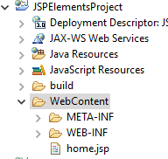
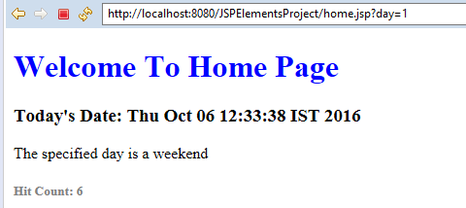
Generate the following output using JSP

Slide 10
JSP implicit objects
JSP supports nine automatically defined variables, which are also called implicit objects.
Objects | Description
request | This is HttpServletRequest object associated with the request. Request objects are passed as parameters to _jspService() method when a client request is made.
response | This is HttpServletResponse object associated with the response to the client. Response objects carry the response of a client request after the _jspService() method is executed.
out | This is PrintWriter object used to send output to the client.
session | This is HttpSession object associated with the request. The session object helps access session data.
application | The application object refers to the entire environment of a web application to which a JSP page belongs. The ServletContext (for sharing data) as obtained via getServletContext().
10

Slide 11
JSP implicit objects
Objects | Description
config | The config object specifies the configuration of the parameters passed to a JSP page. This is the ServletConfig object associated with the page.
pageContext | The pageContext object represents the context of the current JSP page. This encapsulates use of server-specific features like higher performance JspWriters.
page | This is simply a synonym for this, and is used to call the methods defined by the translated servlet class.
exception | The Exception object allows the exception data to be accessed by designated JSP.
11

Slide 12
Java EE
JSP Directives
JSP Action Tags

Slide 13
JSP Directives
JSP Directives:
A JSP directive elements provide information to JSP container about the page.
<%@ directive attribute="value" %>
There are three types of directive tags:
Directive | Description
<%@ page ... %> | Defines page-dependent attributes, such as scripting language, error page, and buffering requirements.
<%@ include ... %> | Includes a file during the translation phase.
<%@ taglib ... %> | Declares a tag library, to include third-party tag libraries such as JSTL, Spring form tags etc. or custom tag libraries.
13

Slide 14
JSP Page Directives
The page directive has the following form:
<%@ page attributes %>
 |  | Ex. <%@ page language="java" contentType="text/html; charset=ISO-8859-1" pageEncoding="ISO-8859-1" import="com.cgs.businesstier.Employee"%>
Attribute | Purpose
contentType | Defines the character encoding scheme.
errorPage | Defines the URL of another JSP that reports on Java unchecked runtime exceptions.
isErrorPage | Indicates if this JSP page is a URL specified by another JSP page's errorPage attribute.
extends | Specifies a super class that the generated servlet must extend
import | Specifies a list of packages or classes for use in the JSP as the Java import statement does for Java classes.
isThreadSafe | Defines the threading model for the generated servlet.
language | Defines the programming language used in the JSP page.
session | Specifies whether or not the JSP page participates in HTTP sessions
14

Slide 15
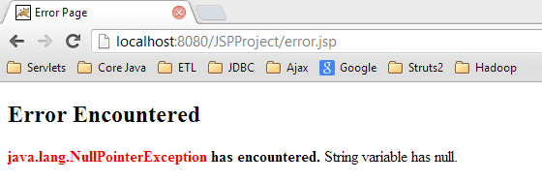
errorPage & isErrorPage example
sample.jsp
error.jsp
<%@ page errorPage="error.jsp" language="java"
contentType="text/html; charset=ISO-8859-1"
pageEncoding="ISO-8859-1"%>
………..
<body>
<%!
String string = null;
%>
The length of the string is <%= string.length() %>
</body>
</html>
Note: Run sample.jsp on external
browser
<%@ page language="java" contentType="text/html; charset=ISO-
pageEncoding="ISO-8859-1" isErrorPage="true"%>
<h2>Error Encountered</h2>
<b><font color="red"><%= exception %></font> has encountered. </b>String variable has null.
</body>
</html>
8859-1"
…….
<body>
15

Slide 16
JSP directive - include
The include directive can be used to include the contents of some other file in a JSP. Example:
<%@ include file="../header.html" %>
The contents of the included file will be pasted as a part of the JSP
16

Slide 17
JSP Action Tags
JSP actions or action tags are the constructs that follows an XML syntax.
The behavior of the servlet engine is controlled by these action. Using JSP actions, a file can be inserted into another page dynamically, reuse a bean component, or forward a user from one page to another page.
The following are the JSP action tags.
inserting other page resources: <jsp:include page="">
forwarding the request to another page: <jsp:forward page="">
To append parameters while forwarding request object from source page to target page: <jsp:param>
creating and locating the java bean instances: <jsp:useBean ….. >
setting and retrieving bean properties, in JSP pages: <jsp:getProperty ….> & <jsp:setProperty ..>
Note : Instead of writing Java code in a scriptlet, developers use special JSP action tags, for example to link to a Java bean to set its properties, or get its properties.

Slide 18
include action tag
The include action tag allows a static or dynamic resource such as HTML or JSP pages, specified by a URL, to be included in the current JSP while processing a request.
General syntax of include action Tag:
<jsp:include page="{relativeURL | <%= expression %> }” />
include action in JSP is used to include static or dynamic resource in JSP file
Elements of this action is processed at the time of the JSP page execution.
Here in case of the static resource, contents are inserted into the calling JSP file.
In case of dynamic resource, the included resource receives the request object and gets executed.
The result is included in the calling JSP file.
Syntax for a dynamic resource:
<jsp:include page="{relativeURL | <%= expression %>}" >
<jsp:param name="parameterName" value="{parameterValue | <%= expression %>}" />
</jsp:include>

Slide 19
forward action tag
The jsp:forward tag forwards the request to another resource. The resource can be dynamic or static.
Syntax
<jsp:forward page="URL" />
<jsp:forward page="URL" >
<jsp:param name="ParamName1" value="ParamValue1" />
<jsp:param name="ParamName2" value="ParamValue2" />
</jsp:forward>
This action tag compliments the forward() method of RequestDispatcher object.
Note: One factor that you need to keep in mind when using this tag is its interaction with output buffering. When the processing of a page encounters a <jsp:forward/> tag all output generated so far will be cleared

Slide 20
Difference Between Include Directive and Include action
include Directive: <%@ include file= "index.jsp" %>
At JSP page translation time, the content of the file given in the include directive is ‘pasted’ as it is, in the place where the JSP include directive is written in the source page. Then the source JSP page is converted into a java servlet class.
The original JSP file will not get affected if there is a change in the included JSP file.
Include Action: <jsp:include page= "index.jsp" >
The jsp:include action element is like a function call. At runtime, the included file will be ‘executed’ and the result will be included with the source JSP page. When the included JSP page is called, both the request and response objects are passed as parameters.

Slide 21
Calling a servlet from a JSP : html form action
<html><head>
<meta http-equiv="Content-Type" content="text/html; charset=ISO-8859-1">
<title>JSP Calling servlet through form action tag of html</title>
</head><body>
<H1> Call Servlet from JSP </H1>
<FORM method="POST" action="/JSPProject/CounterServlet">
<P> <INPUT type="submit" name="CALL_SERVLET" value="Call the Servlet">
</FORM>
</body></html>
Calling a servlet from a JSP : jsp:forward
<html> Invoking a Servlet from a JSP directly through the jsp:include or jsp:forward tags.
<head>
<meta http-equiv="Content-Type" content="text/html; charset=ISO-8859-1">
<title>Call the servlet through jsp:forward tag</title>
In reality, It is other way , i.e. A Servlet that
</head>
<body>
acts as a controller invokes JSP
<p> Calling Servlet from JSP </p>
<jsp:forward page="/JSPProject/CounterServlet"></jsp:forward>
</body>

Slide 22
Invoking a JSP from a JSP
To invoke a JSP file from another JSP file, you can perform one of the following:
Specify the URL of the second JSP file on the FORM ACTION attribute:
<FORM action="JSP_URL">
Specify the URL of the second JSP file in an anchor tag HREF attribute:
<a href="JSP_URL"> reference-text </a>
Using <jsp:forward > or <jsp:include> action tags.

Slide 23
Java EE
Invoking JSP from a Servlet
Java Bean
JSP Action Tags: useBean, getProperty & setProperty
Expression Language (EL)
JSP Standard Tag Library (JSTL)

Slide 24
Invoking a JSP Page from a Servlet
You can invoke a JSP page from a servlet through functionality of the standard javax.servlet.RequestDispatcher interface.
Complete the following steps in your code to use this mechanism:
Get a servlet context instance from the servlet instance:
ServletContext sc = this.getServletContext();
Get a request dispatcher from the servlet context instance, specifying the absolute path of the target JSP page as input to the getRequestDispatcher() method:
RequestDispatcher rd = sc.getRequestDispatcher("/jsp/mypage.jsp");
Invoke the include() or forward() methods of the request dispatcher, specifying the HTTP request
and response objects as arguments.
rd.include(request, response); or rd.forward(request, response);
The functionality of these methods is similar to that of jsp:include and jsp:forward actions.
Note : MVC Architecture is implemented using the above technique

Slide 25
About Java beans
A JavaBean is a Plain Old Java object (POJO) that is Serializable, has a 0-argument i.e. no-arg constructor, and allows access to its properties using getter and setter methods.
Java Beans are Java classes that obey the following conventions:
– Must have a zero-argument (empty) constructor
You can satisfy this requirement either by explicitly defining such a constructor or by omitting all constructors
Should have no public instance variables (fields)
Persistent values should be accessed through methods called getXxx
•
If class has method getTitle() that returns a String, class is
said to have a String property named title
Boolean properties may use isXxx instead of getXxx
•
Note : It is the name of the method, not instance variable that matters!

Slide 26
Using Beans : Basic tasks
jsp:useBean
– In the simplest case, this element instantiates a java bean, or to locate an existing bean instance, and assign it to id.
It is used as:
<jsp:useBean id="beanName" class="package.Class " scope= " request" />
jsp:setProperty
-This element modifies a bean property (i.e., calls a setXXX method
It is used as:
<jsp:setProperty name="beanName" property="propertyName" value="propertyValue" />
jsp:getProperty
– This element reads and outputs the value of a property.
It is used as:
<jsp:getProperty name="beanName"
property="propertyName" />
Example:
<jsp:useBean id="book1" class= "
com.lnt.businesstier.Book" />
is equivalent to the scriptlet
<% org.asr.beans.Book book1 = new com.lnt.businesstier.Book.Book(); %>
).
But jsp:useBean has two additional advantages:
It is easier to derive object values
from request parameters
It is easier to share objects among pages or servlets

Slide 27
Attributes of <jsp:usebean> tag
Attributes of the <jsp:useBean> Tag:
Id: The id attribute of the jsp:useBean action tag represents the variable name assigned to the id
attribute of the jsp:useBean.
scope: The scope attribute represents the scope in which the bean instance has to be located or created. scopes can be page, request, session or application.
page (default) : It means that we can use the Bean within the JSP page.
request: We can use the bean from any JSP page processing the same request.
session: We can use the bean from any JSP page in the same session as the jsp page that created
the bean.
application: We can use the bean from any page in the same application as the jsp page that created the bean.
class: It takes the qualified class name (packagename.classname) to create a bean instance if the
bean instance is not found in the given scope.

Slide 28
Setting Java Bean properties from request parameters
To set the Java Bean properties from request parameters, we can use param attribute as shown below:
<jsp:useBean id="myBeanAttribute" class="com.lnt.businesstier.MyBean" scope="session">
<jsp:setProperty name="myBeanAttribute" property="id" param="empID" />
</jsp:useBean>
If property and param attribute values are same, we can skip the param attribute. For example if request parameter name is also id then we can simply write:
<jsp:useBean id="myBeanAttribute" class="com.lnt.businesstier.MyBean" scope="session">
<jsp:setProperty name="myBeanAttribute" property="id" />
</jsp:useBean>
If all the request parameter names matches with the java bean properties, then we can simply set bean properties as shown below.
<jsp:useBean id="myBeanAttribute" class=" com.lnt.businesstier.MyBean " scope="session">
<jsp:setProperty name="myBeanAttribute" property="*" />
</jsp:useBean>

Slide 29
Using Expression Language (EL) in a JSP Page
An EL expression is delimited in a JSP page using the notation:
${el-expression-goes-here}
When the JSP is executed, the value of the expression is determined and the delimiters, along with the enclosed expression, is replaced with the text evaluation of the result.
For example, the EL expression ${ 3 + 4 } will be replaced with the text 7 in the response output
or attribute value.
So, When the JSP compiler sees the ${} form in an attribute, it generates code to evaluate the
expression and substitutes the value of expression.

Slide 30
Accessing Java Bean properties
While strings and numbers are useful for representing scalar values, more frequently, complex objects in the form of JavaBeans are what we have to deal with, so the EL is speciﬁcally designed to make it easy to access the properties of JavaBeans.
For example, If an instance of this class were to be created as a scoped variable named person, we can use the EL's property operator to reference the property values.
This operator has two forms:
The simplest and most commonly-used form is the dot (period) character.
For example, to reference the bean's title property:
${person.title}
${person.firstName}
The other form of the property operator consists of square bracket characters([]) which contain an expression whose string evaluation is taken as the property to be referenced.
${person['title']}
This expression is identical to ${person.title}

Slide 31
Building Web Applications using MVC 2 Architecture

Slide 32
Building Web Applications
Simple
Application
Scripting elements calling servlet code directly
Scripting elements calling servlet code indirectly (by means of utility classes)
Beans
Servlet/JSP combo (MVC 2 Architecture)
MVC with JSP expression language (JSTL)
Custom tags
Complex
Application
MVC with beans and a framework like Struts or JSF or Spring

Slide 33
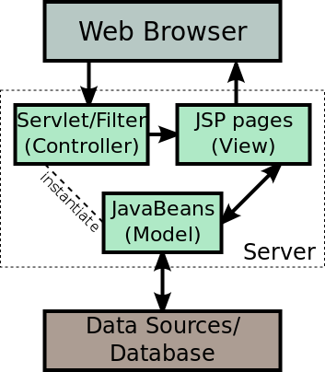
MVC Model 2 Architecture
MVC based frameworks are: Struts 2 , JSF , Spring etc.
In JSP Model 2 architecture , JSP is used for creating the view for the application.
A centralized Servlet is used to handle all the request for the application. The Servlet works as the controller for the application. It then uses the Java beans for processing the business logic and getting the data (Model) from the database.
Finally it uses the JSP to render the view which is displayed to the user.

Slide 34
Why MVC ?
Combination (MVC architecture). Needed when:
– A single request will result in multiple substantially different-looking
results.
You have a large development team with different team members doing the Web development and the business logic.
You perform complicated data processing, but have a relatively
fixed layout.

Slide 35
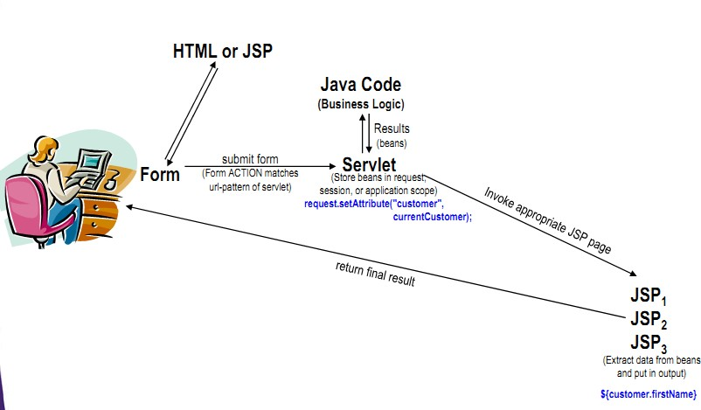
MVC Flow of Control

Slide 36
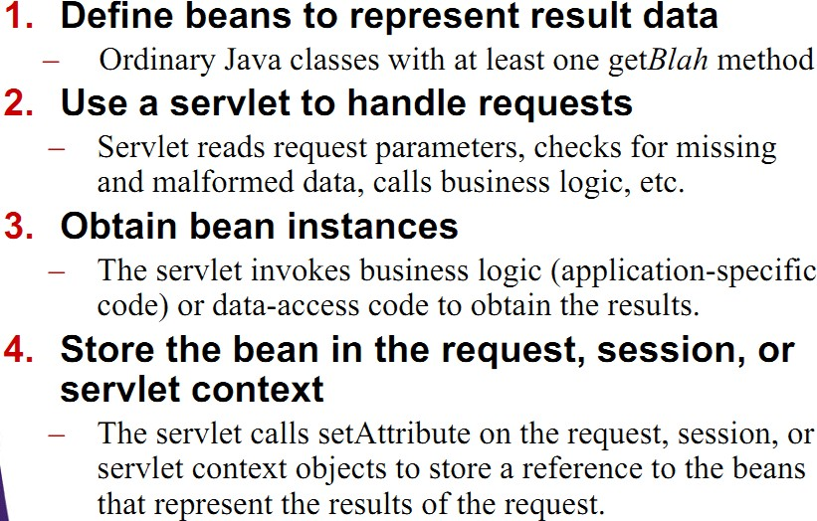
Implementing MVC Architecture with Servlet and JSP API

Slide 37
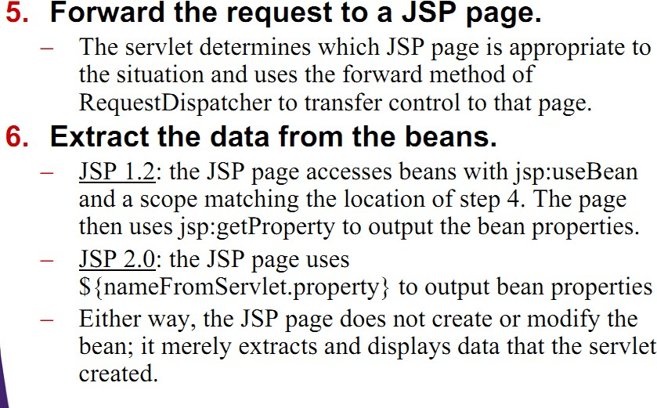
Implementing MVC Architecture with Servlet and JSP API

Slide 38
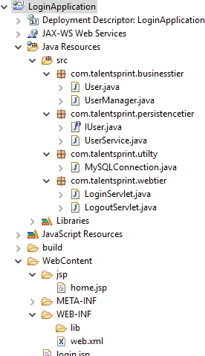
Login Application
CREATE TABLE university.users ( userid INT NOT NULL, username VARCHAR(30) NULL, password VARCHAR(20) NULL, status VARCHAR(20) NULL,
PRIMARY KEY (userid)
);
http://bootsnipp.com/

Slide 39
Login Application
login.jsp accepts credentials and passes it on to LoginServlet.
LoginServlet invokes verifyCredentials() method of UserManager class to validate username and
password entered by the user.
The verifyCredentials() method of UserManager class invokes verifyCredentials() method of UserService class which in turn connects to database and verifies whether the credentials are registered in the users table, returns true/false.
If credentials are valid , create session object and render home page( home.jsp) to the browser else
render login.jsp.
home.jsp provide a hyperlink to logout( invokes LogoutServlet)
LogoutServlet invalidates the session and send html content “ You have logged out of the application. Than Q” and also provides an hyperlink to login.

Slide 40
Login Application
Dynamic Web Project: LoginApplication
Package: com.cgs.webtier
Servlets: LoginServlet , LogoutServlet
Package: com.cgs.businesstier
class: UserManager
instance method:
public Boolean verifyCredentials(User user)
Note: Invokes verifyCredentials() method of UserService class com. cgs.persistencetier
class: UserService
instance method:
public Boolean verifyCredentials(User user) : This method connects to database and verifies
whether the credentials are registered in the users table, returns true/false
Package:
Package: com. cgs.utility
class: MySQLConnection
Create a folder, jsp under WebContent : Files in this folder are home.jsp , login.jsp

Slide 41

login.jsp
<h1>Login Screen</h1>
<form action="LoginServlet" method="POST">
Enter username:<input type="text" name="username“ size=“20” >
Enter password: <input type="password" name="password“ size=“20” >
<input type="submit" value="Submit“>
</form>

Slide 42
LoginServlet
protected void doGet(HttpServletRequest request, HttpServletResponse response) throws ServletException, IOException {
PrintWriter out=response.getWriter();
String username= request.getParameter("username"); String password=request.getParameter("password"); UserManager manager=new UserManager();
Boolean flag=manager.verifyUsernameAndPassword(username, password);
if(flag==true){
HttpSession session=request.getSession(true); session.setAttribute("username", username); String uri= "views/main_menu.jsp"
request.getRequestDispatcher(uri).forward(request, response);
//out.println("<html><body"+"<h1>Hi! Welcome "+username+"</h1></body></html>");
}else{
out.println("<html><body"+"<h1>"+"Invalid Credentials"+"</h1>"+"</body></html>"); out.println("<a href=\"login.jsp\">"+"Login"+"</a>");
}
}

Slide 43
LogoutServlet
protected void doGet(HttpServletRequest request, HttpServletResponse response) throws ServletException, IOException {
HttpSession session=request.getSession(false); PrintWriter out=response.getWriter(); if(session!=null){
session.removeAttribute("username"); session.invalidate();
out.println("<a href=\"login.jsp\">"+"Login"+"</a>");
}else{
out.println("Please Login<br>");
out.println("<a href=\"login.jsp\">"+"Login"+"</a>");
}
}

Slide 44
Prevent the browsers from caching
The root of the problem is the Back button that exists on most modern browsers. When the Back button is clicked, the browser by default does not request a page from the Web server. Instead, the browser simply reloads the page from its cache
To leverage the HTTP headers' cache directives, the following code snippet should be placed at the top of all protected JSP pages.
//...
response.setHeader("Cache-Control","no-cache"); //Forces caches to obtain a new copy of the page from the origin server response.setHeader("Cache-Control","no-store"); //Directs caches not to store the page under any circumstance response.setDateHeader("Expires", 0); //Causes the proxy cache to see the page as "stale" response.setHeader("Pragma","no-cache"); //HTTP 1.0 backward compatibility
String userName = (String) session.getAttribute("User"); if (null == userName) {
request.setAttribute("Error", "Session has ended. Please login."); RequestDispatcher rd = request.getRequestDispatcher("login.jsp"); rd.forward(request, response);
}
//...

Slide 45
JSP Standard Tag Library (JSTL)
JSTL allows us to write JSP pages using tags, rather than the scriptlet code
JSTL provides standard tag libraries into four groups
core
XML
Internationalization/format
SQL
The primary design goal for JSTL and the EL (Expression Language) is to simplify webpage development and implementation.
Note: Apache Tomcat 8 supports Java Servlet 3.1, Java Server Pages 2.3 and Expression Language
3.0 specifications.
JSTL is by default not available in Tomcat. So, download jstl-1.2.jar file and place it into your project’s classpath.

Slide 46
Java Standard Tag Library (JSTL) Groups
Although JSTL is officially named the Java Server Pages Standard Tag Library, it divides its tags into four groups and makes them available as separate tag libraries.
The following table lists the different libraries, along with their URIs and prefixes:
JSTL tag library | prefix | URI | Example Tag
Core Library | c | <%@ taglib uri="http://java.sun.com/jsp/jstl/core" prefix="c" %> | <c:forEach>
XML processing library | x | <%@ taglib uri="http://java.sun.com/jsp/jstl/xml" prefix=“x" %> | <x:forEach>
Internationalization and formatting | fmt | <%@ taglib uri="http://java.sun.com/jsp/jstl/fmt" prefix=“fmt" %> | <fmt:formatDate>
Database Access (SQL) | sql | <%@ taglib uri="http://java.sun.com/jsp/jstl/sql" prefix=“sql" %> | <sql:query>
The core group of tags are the most frequently used JSTL tags.
Note: Earlier JSTL versions used URI: http://java.sun.com/jstl/core which is now revised to above specified URI.

Slide 47
JSTL Core Tags
Tags | Description
c:out | It display the result of an expression, similar to the way <%=...%> tag work.
c:import | It Retrives relative or an absolute URL and display the contents to either a String in 'var',a Reader in 'varReader' or the page.
c:set | It sets the result of an expression under evaluation in a 'scope' variable.
c:remove | It is used for removing the specified scoped variable from a particular scope.
c:catch | It is used for Catches any Throwable exceptions that occurs in the body.
c:if | It is conditional tag used for testing the condition and display the body content only if the expression evaluates is true.
c:choose,c:when, c:otherwise | It is the simple conditional tag that includes its body content if the evaluated condition is true.
c:forEach | It is the basic iteration tag. It repeats the nested body content for fixed number of times or over collection.
c:forTokens | It iterates over tokens which is separated by the supplied delimeters.
c:param | It adds a parameter in a containing 'import' tag's URL.
c:redirect | It redirects the browser to a new URL and supports the context-relative URLs.
c:url | It creates a URL with optional query parameters.

Slide 48
JSTL Core Tag Examples
jstl_demo1.jsp
<c:set var="income" scope="session" value="${4000*4}"/>
<p>Your income is : <c:out value="${income}"/></p>
<c:choose>
Note: jstl-1.2.jar file to be placed in your project’s classpath
<c:when test="${income <= 1000}">
Income is not good.
</c:when>
<c:when test="${income > 10000}">
Income is very good.
</c:when>
<c:otherwise>
<%-- <c:url> is equivalent to response.encodeURL() method --%>
<c:url value="/index1.jsp" var="completeURL">
<c:param name="trackingId" value="786"/>
<c:param name="user" value="Ravi"/>
</c:url>
${completeURL}
Income is undetermined...
</c:otherwise>
</c:choose>
jstl_demo2.jsp
<%-- <c:redirect> is equivalent to response.sendRedirect() method --%>
<c:set var="id" value="0" scope="request"/>
<%-- JSTL does not have elseif tag --%>
<c:if test="${id<1}">
<c:redirect url="http://google.com"/>
</c:if>
<c:if test="${id>1}">
<c:redirect url="http://microsoft.com"/>
</c:if>

Slide 49
<c:forEach> Example
jstl_demo3.jsp
<%@ page language="java" contentType="text/html; charset=ISO-8859-1"
pageEncoding="ISO-8859-1" import="java.util.Map,java.util.HashMap"%>
<%@ taglib prefix="c" uri="http://java.sun.com/jsp/jstl/core" %>
…….
<body>
<%
Map<String, String> countryCapitalMap = new HashMap<>(); countryCapitalMap.put("United States", "Washington DC"); countryCapitalMap.put("India", "Delhi");countryCapitalMap.put("Germany", "Berlin"); countryCapitalMap.put("France", "Paris");countryCapitalMap.put("Italy", "Rome");
request.setAttribute("capital", countryCapitalMap);
%>
<%-- JSP Code --%>
<table border="1">
<tr><th bgcolor="green">COUNTRY</th><th bgcolor="green">CAPITAL</th></tr>
<c:forEach var="c" items="${capital}">
<tr><td>${c.key}</td><td>${c.value}</td></tr>
</c:forEach>
</table>
</body></html>

Slide 50

<c:forEach> Example
……….
servlet
request.setAttribute("customerList", customerList);
uri="views/show_all_customers.jsp";
}else{
throw new Exception("No Customers in the database");
}
}
request.getRequestDispatcher(uri).forward(request, response);
…………
<c:forEach var="c" items="${customerList}">
<tr>
<td class="hidden-xs">${c.customerId}</td>
<td>${c.customerName }</td>
<td>${c.customizedBirthdate}</td>
<td>${c.address}</td>
<td>${c.email}</td>
<td>${c.mobile}</td>
</tr>
</c:forEach>

Slide 51
<c:forEach> Example
<%@ page language="java" contentType="text/html; charset=ISO-8859-1" pageEncoding="ISO-8859-1" isELIgnored="false"%>
<%@ taglib uri="http://java.sun.com/jsp/jstl/core" prefix="c" %>
……….
<head>
<link rel="stylesheet" href="http://maxcdn.bootstrapcdn.com/bootstrap/3.3.6/css/bootstrap.min.css">
</head>
<body>
<jsp:useBean id="customerList" type="java.util.List<Customer>" scope="request"/>
<div class="container">
<h2>Customer Details</h2>
<table class="table">
<thead>
<tr> <th>Customer ID</th><th>Customer Name</th><th>Birthdate</th><th>Mobile</th>
<th>Address</th> <th>Email</th> <th>Password</th> <th>Edit</th><th>Delete</th>
</thead>
<tbody>
<c:forEach var="c" items="${customerList}">
<tr class="success">
<td>${c.customerId}</td><td>${c.customerName}</td><td>${c.customDate}</td>
<td>${c.mobile}</td><td>${c.address}</td><td>${c.email}</td><td>${c.password}</td>
<td><a href="updatecustomer?custid=${c.customerId}">edit</a></td>
<td><a href="deletecustomer?custid=${c.customerId}">delete</a></td>
</tr>
</c:forEach>
</tbody>
</table>
</div>
</body></html>
</tr>

Slide 52

Thank You!

